Slide 1
Identifying depression
among students
Capstone Project 2
Trevor DeMarco

Slide 2

The Premise
Assess the viability of using surveyed data to identify struggling students.
Determine aspects of academia that institutions could potentially reflect on and change for the benefit of students.
Image via adobe stock

Slide 3
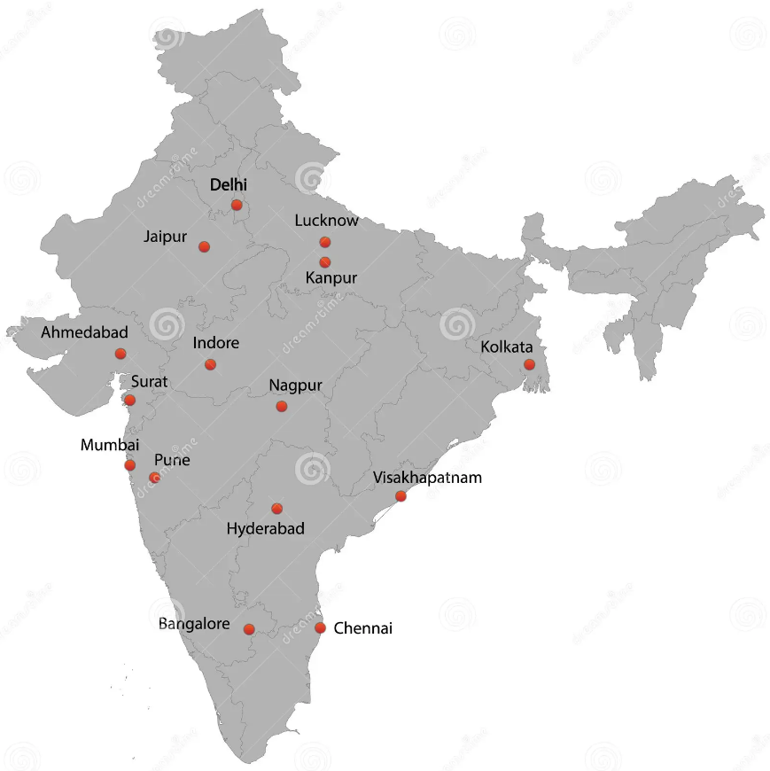
The Data
28,000 students surveyed across ~50 cities in India.
Focuses on academic and personal lifestyle.
Age/Gender
Work/Study hours
Satisfaction levels
Image via dreamstime

Slide 4
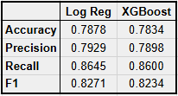
Model Comparison:
Logistic Regression vs Gradient Boosting
Produced near identical results.
Logistic Regression technically better for this dataset.
Additional considerations:
Random forest
Naive Bayes
K Nearest Neighbors

Slide 5
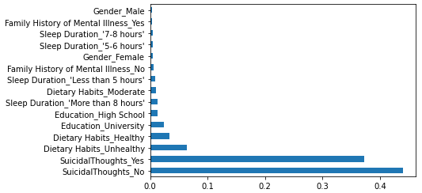
Insights
Model(s) seem to have produced viable results.
Academic and financial pressure stand out on their own.
Per random forest tests suicidal thoughts and dietary habits were most connected to the target variable.
Features sorted by importance

Slide 6
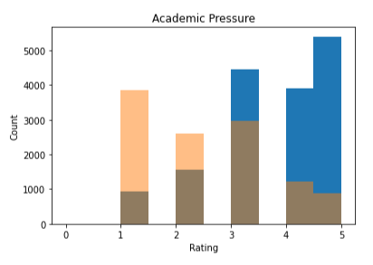
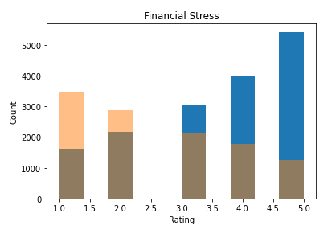
Actions
Pursue and encourage data collection.
Establish some form of student outreach.
Continue to use models to identify target areas for improvement.
Iterate and reflect.
68% feel academic pressure at a 3 or higher
63% feel financial stress at a 3 or higher

Slide 7
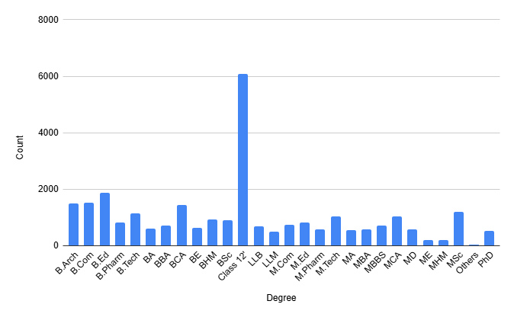
Improvements
Utilize city and degree data.
Explore additional models.
Acquire more in-depth and diverse data.
Dataset contains a large amount of degrees, could lead to additional findings.

Slide 8
Links & Questions
Research notebook and slides:
ds_work/Capstone 2 at main · trevorademarco/ds_work
Dataset:
via Shodolamu Opeyemi - Kaggle
Student Depression Dataset.

